Slide 1
10th Annual Cochrane Canada Symposium: Health Evidence for All Winnipeg, May 2012

Slide 2
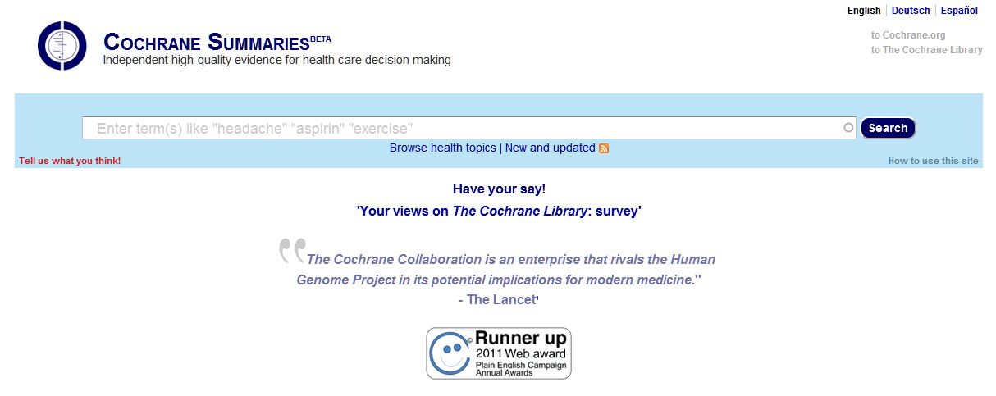
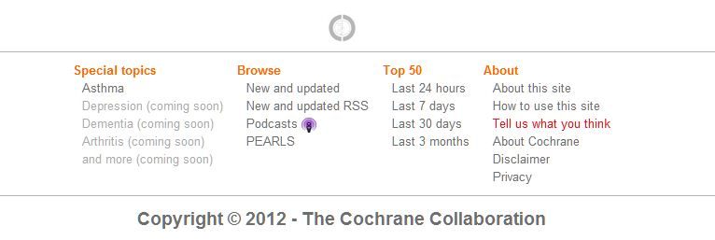
The New Home Page

Slide 3
Plain Language Award

Slide 4
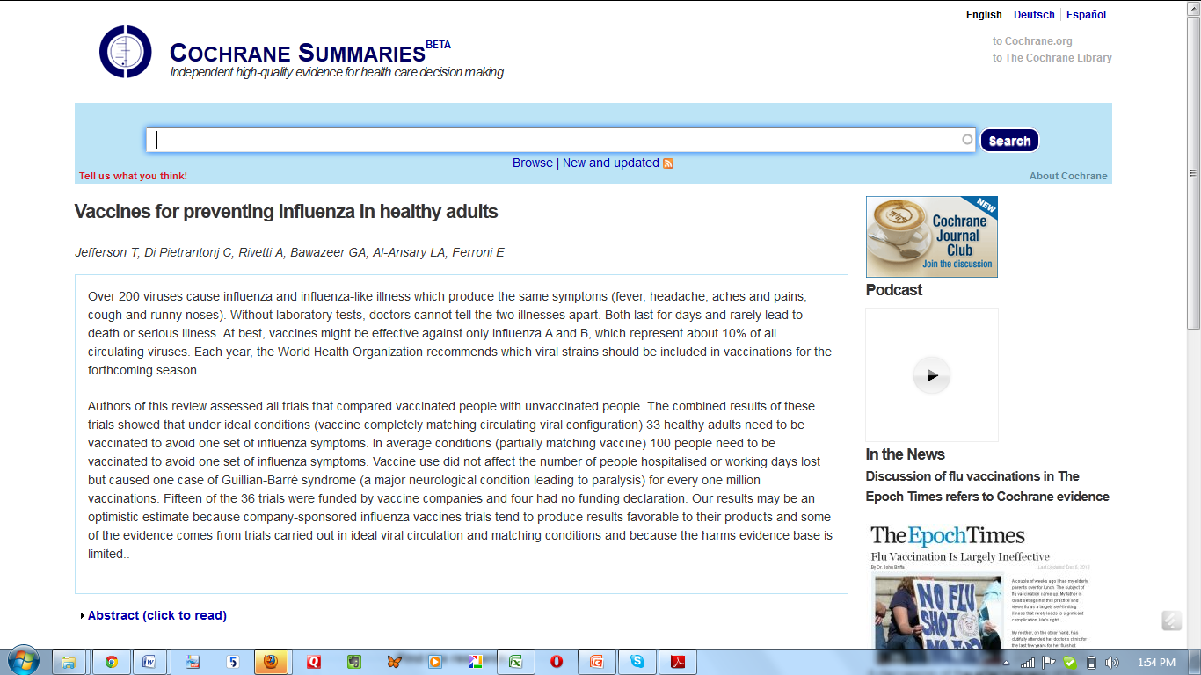
http://summaries.cochrane.org

Slide 5
Adaptive

Slide 6
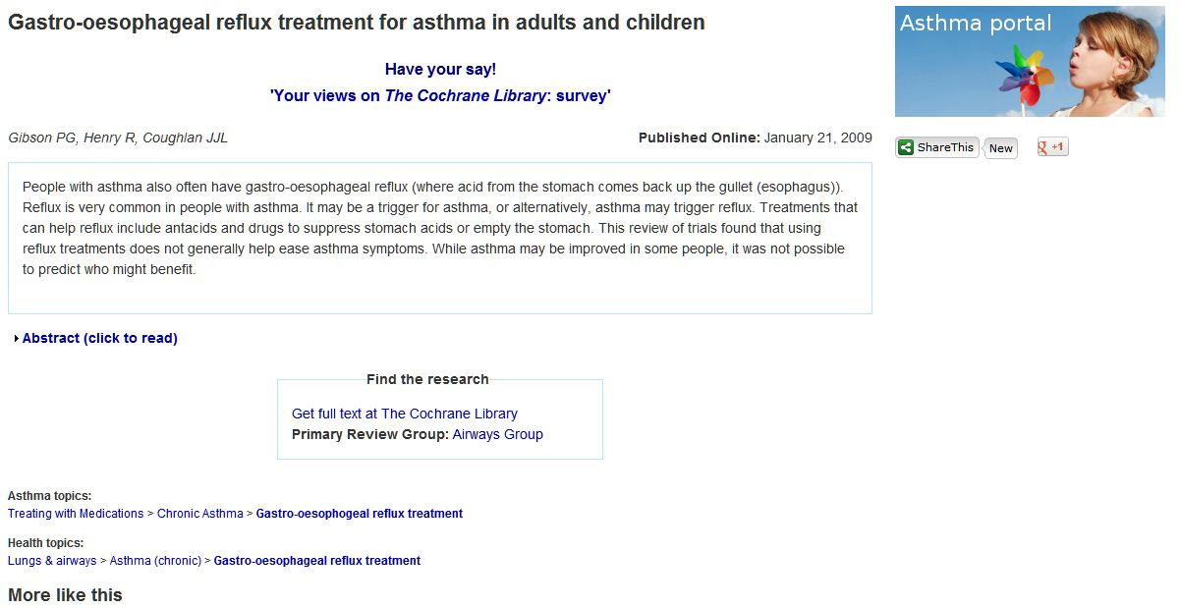
More Interactive

Slide 7
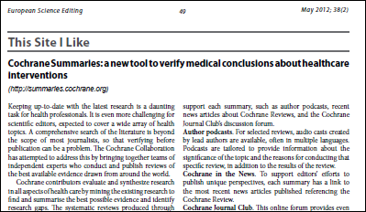
Journal of European Science Editing

Slide 8
Most Visitors Come Via Search Engines

Slide 9
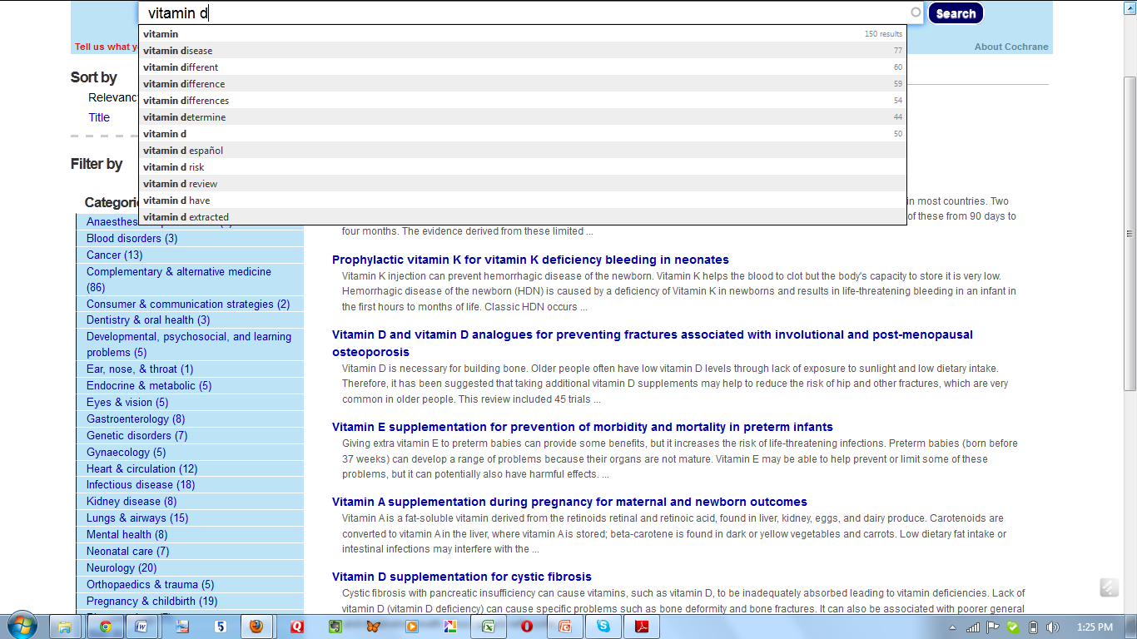
Search Titles and Text

Slide 10
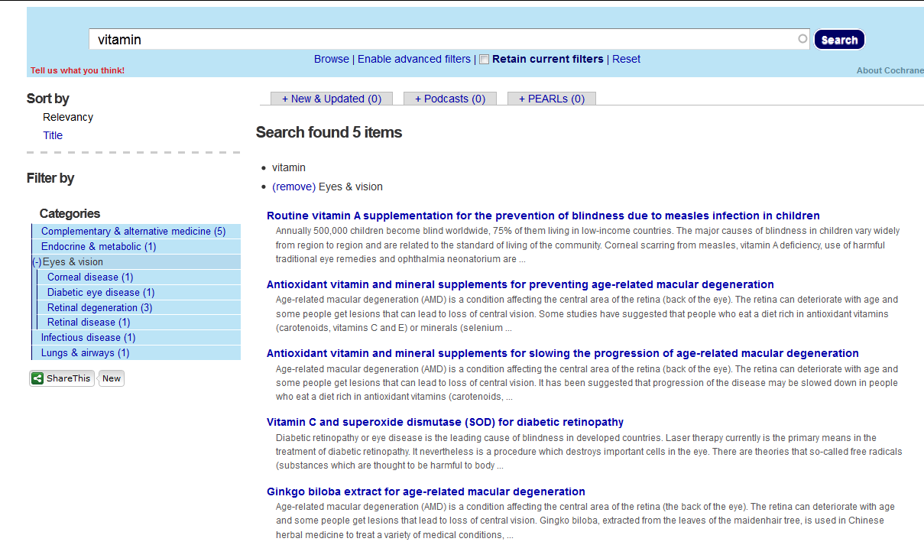
Browse Options

Slide 11
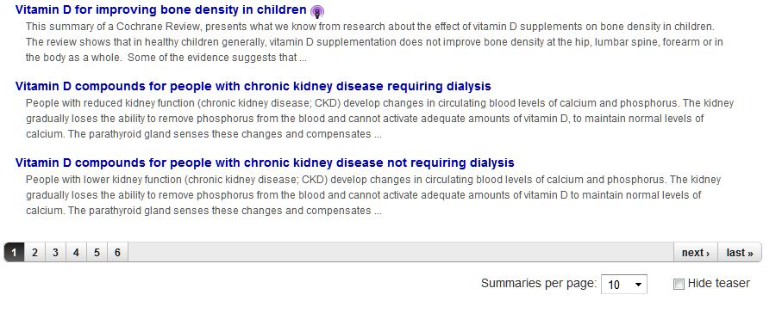
Improved Scanning

Slide 12
Plain Language Summaries

Slide 13
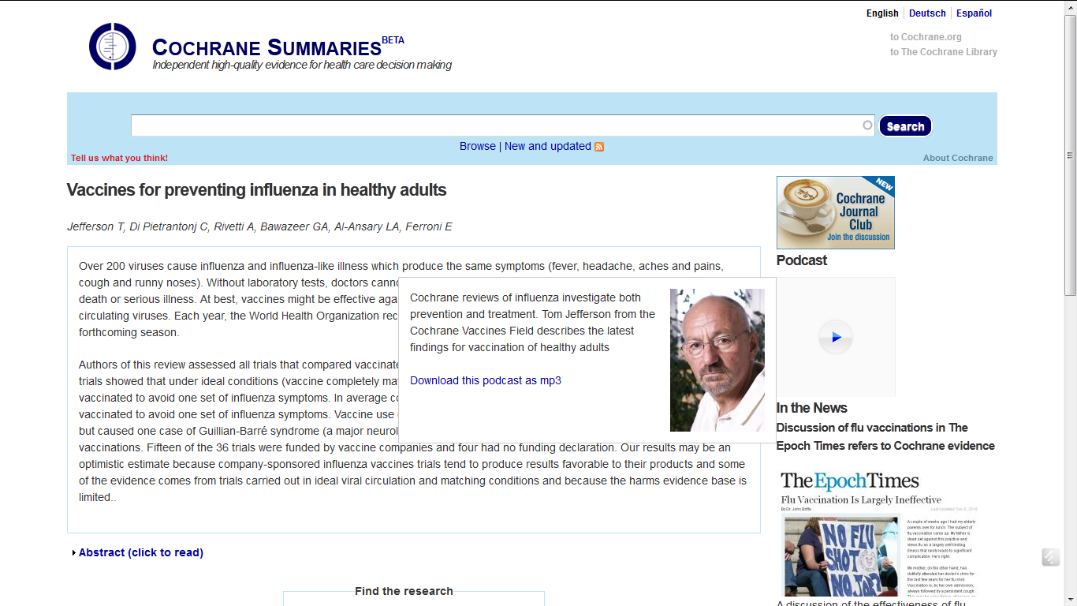
Author Podcasts

Slide 14
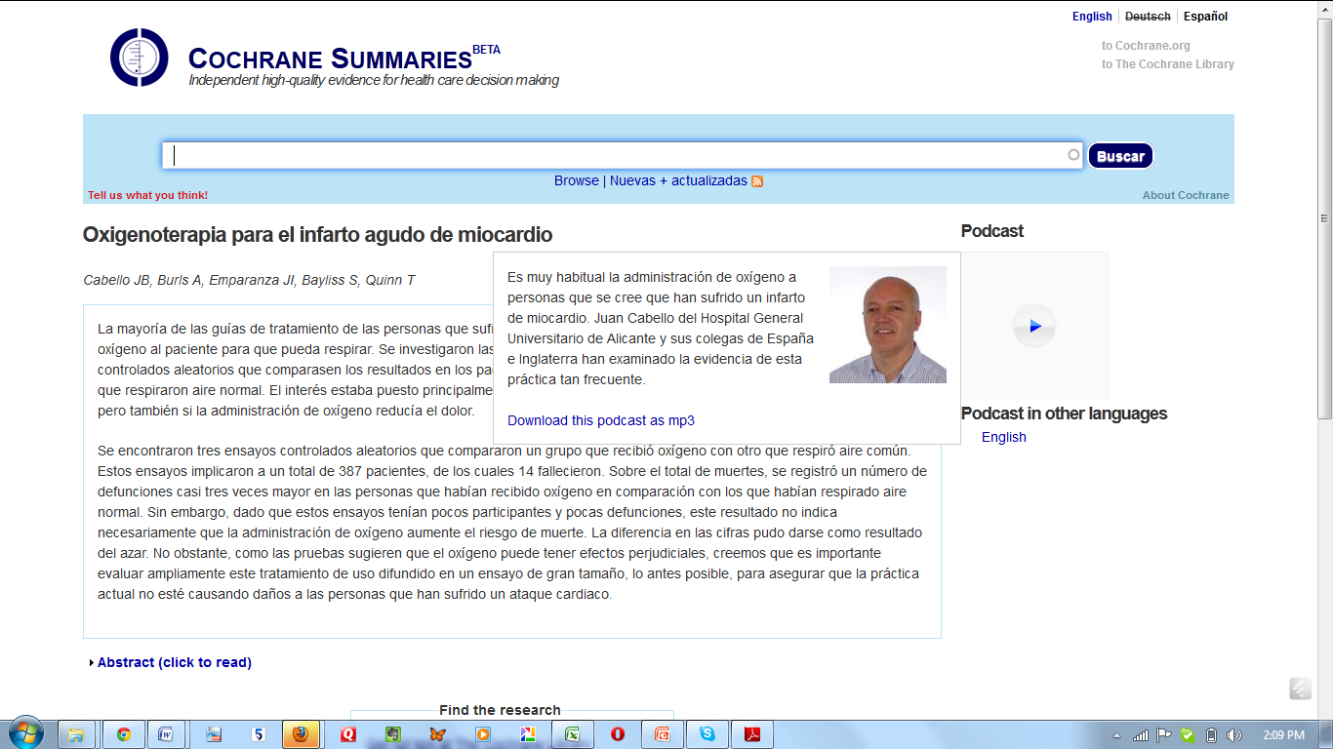
Translations

Slide 15
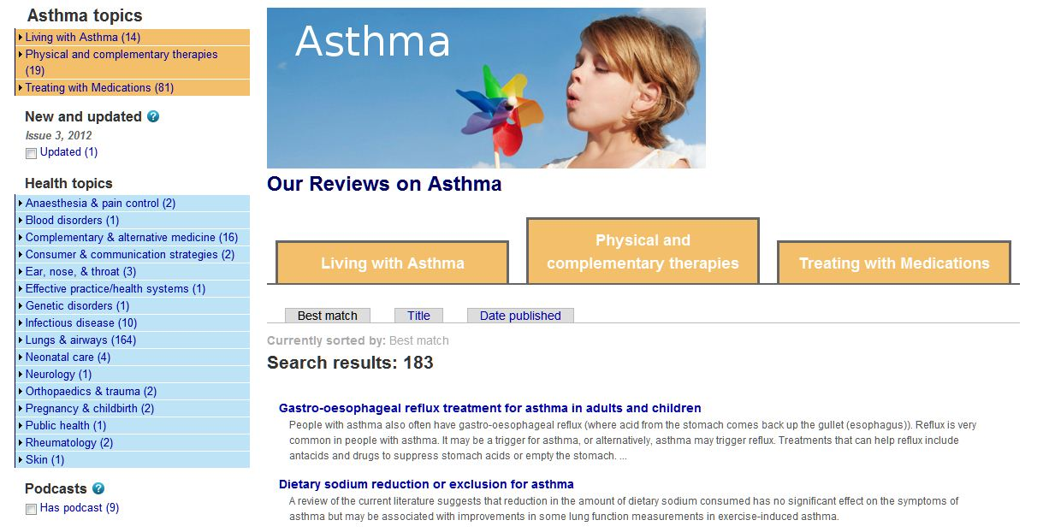
The Asthma Portal

Slide 16
Consumer topics

Slide 17
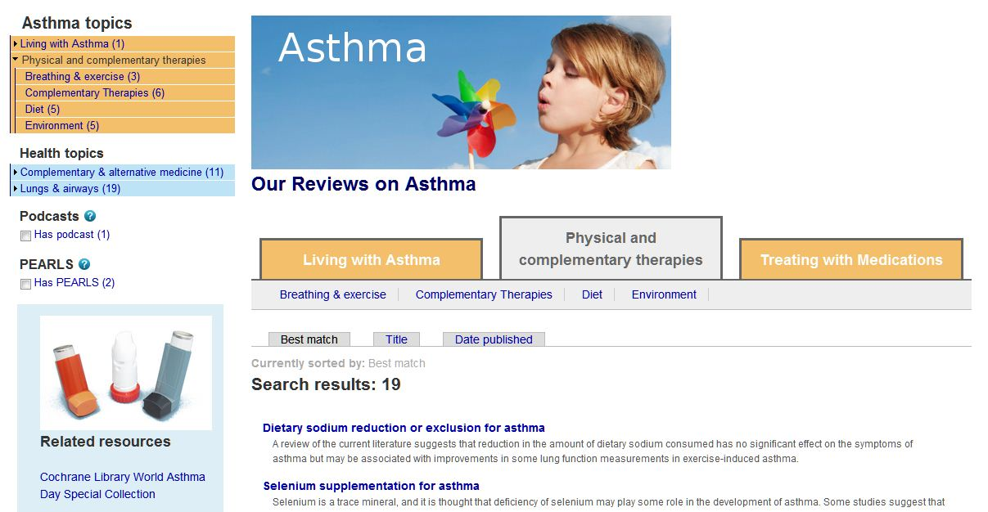
2-3 Layer Browse

Slide 18
Sort Results

Slide 19
More Ways to Browse

Slide 20
New Information

Slide 21
Flexible Design

Slide 22
Potential for New Resources

Slide 26
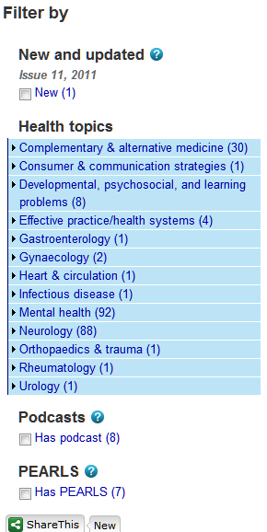
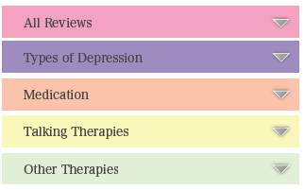
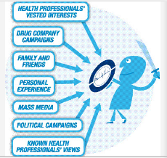
Dementia
Welcome to the Cochrane Dementia Portal
Select an option on the left to browse our reviews.
Dementia is ...............................................................................................................................................................................................................................................................

Slide 27
We’re Looking For More Portals

Slide 28
Key Contributors
Chris Mavergames
Martin Janczyk
Lorne Becker
The Cochrane Editorial Unit
The Cochrane Airways Group
The Cochrane Depression, Anxiety and Neurosis Group
The Wiley Online Channel Development Team

Slide 29
How Would You Like To See Reviews Displayed?

