Slide 1
Consumer participation in The Cochrane Collaboration: A comparison of models
Gill Gyte
Dell Horey
20 October 2011

Slide 2
Our goals
To develop a framework to analyse consumer participation in Cochrane reviews
To investigate consumer involvement in Cochrane Pregnancy and Childbirth (PCG) reviews
What do consumers add to PCG reviews?
How do different models for involving consumers affect participation?
To recommend future directions for consumer involvement in PCG reviews.

Slide 3
1. FRAMEWORK What is the purpose of Cochrane reviews?
To investigate the effects of interventions for prevention, treatment and rehabilitation.
To help practitioners, consumers, policy-makers and others make health decisions.
To promote the use of evidence-based practice.

Slide 4
1. FRAMEWORK Evidence-based practice
Context
Research evidence
Preferences & values
Feasibility
Effectiveness
Acceptability
Professional expertise
Based on model for evidence-based clinical decisions in Haynes R.B., Devereaux P.J., Guyatt G.H., (2002) Physicians’ and patients’ choices in evidence based practice British Medical Journal. 324(7350):1350

Slide 5
1. FRAMEWORK Evidence-based practice
Feasibility
Effectiveness
Acceptability
What works in this situation?
What’s important to these people?
What treatment or intervention works?

Slide 6
2a. Consumer involvement in PCG reviews Background
The Pregnancy & Childbirth Group (PCG) used a Consumer Panel to provide input into reviews from 1998 to October 2007. It was favourably evaluated in 2003.
Loss of funding meant new model to involve consumers was needed from 2008. The peer review process used for other PCG referees was extended to include consumers.
In 2011 we asked PCG editors and consumers with experience of these two different models of consumer participation:
What does consumer input add to PCG reviews?
How do the two models of consumer participation compare?
7/7 editors and 7/14 consumers responded.

Slide 7
2a. Consumer involvement in PCG reviews What do consumers add to PCG reviews?
Clarify background and rationale of review
Make language more accessible
Evidence of
ACCEPTABILITY
Often the consumer feedback is the most helpful. I think it has helped enhance relevance, understandability and quality of the reviews and protocols. (Editor)
Adds more down to earth ideas which probably relates more closely to those women the studies are aimed at. (Consumer)
Consumers help make the background sections fuller and more useful. (Consumer)
As with other reviewers sometimes consumers pickup important points. They tend to focus more on the understandability of the text which is a good thing. (Editor)

Slide 8
2a. Consumer involvement in PCG reviews What do consumers add to PCG reviews?
Sets implications of reviews in broader context
Evidence of
FEASIBILITY
There is much more at stake than simply ensuring that the wording is accessible to a broad audience. Consumers help to ensure that the most important outcomes are addressed, and that the most important implications for research, practice, and policy are included. (Editor)
Information about customs in different countries or areas. (Consumer)
I think consumer input can add another point of view and highlight elements of an issue that a medical person might not have considered. (Consumer)

Slide 9
2a. Consumer involvement in PCG reviews What do consumers add to PCG reviews?
Identify outcomes important to consumers’ decision-making
Evidence of
EFFECTIVENESS
Consumers often raise questions about outcomes that are generally of less concern to professionals (e.g., longer-term outcomes, full complement of potential harms, impact on quality of life issues). Consumers can help make the topics, reviews, and application of the reviews more woman- and family-centered, thus increasing the likelihood of meaningful uptake and impact. (Consumer)

Slide 10
2a. Consumer involvement in PCG reviews What do consumers add to PCG reviews?
Consumers can improve the quality of PCG reviews by
Increasing their acceptability
Enhancing their feasibility
Identifying measures of effectiveness that are meaningful or appropriate to consumer decision-making.

Slide 11
2b. Consumer involvement in PCG reviews How do different models affect participation ?
Two models have been used by PCG
Consumer panel model 1998-2007
Consumer peer review model 2008-2011
Comparison of these models offers lessons about involving consumers.

Slide 12
2b. Consumer involvement in PCG reviews Model 1: Consumer panel (1998-2007)
Features
Paid consumer coordinator
International coordinator panel
Opt-in model – all consumers involved in the panel invited to comment on all protocols and reviews
Review authors given summary in addition to all consumer comments.
Engagement
73 consumers
69 from high income countries and 4 from low income countries
All reviews and protocols had consumer input
Many had multiple consumer input.

Slide 13
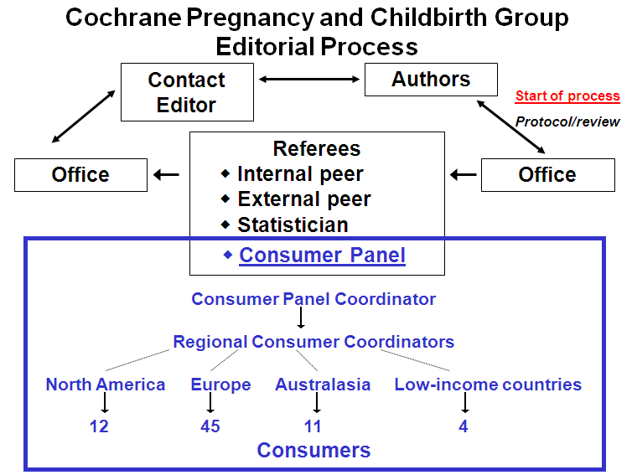

Slide 14
2b. Consumer involvement in PCG reviews Model 2: Consumer peer review (2008-2011)
Features
Peer review model – individual consumers
Consumers selected by editorial office based on stated areas of interest
Review authors given consumer comments .
One consumer only provides input.
Engagement
28 consumers
24 from high income countries and 4 from low income countries
Not all reviews and protocol receive consumer input.

Slide 15
2b. Involving consumers in PCG Cochrane reviews Model 1: Consumer panel (1998-2007)
Editors’ views
More consumer feedback
More detailed consumer feedback
“Comprehensive, varying views captured, all protocols and reviews had input”
Quality of summary important
“respectful of the authors’ contributions”
Saved time.
“The collated comments made it much quicker and easier to understand and use the consumer feedback - so less work for the editor”
Consumer feedback
Broader input
“different experiences and expertise”
Greater opportunity for consumer input
“allowed the possibility of taking feedback in multiple ways according to consumer preference and availability, and taking feedback from all interested parties”
Customised feedback to authors
Consumer leadership
“allowed PCG consumer representation at Colloquia and in other forums beyond the review group”

Slide 16
2b. Involving consumers in PCG Cochrane reviews Model 2: Consumer peer review (2007-2011)
Editor feedback
Feedback more variable or missing
“pretty hit and miss. Sometimes excellent feedback from an individual, sometimes thin feedback, sometimes none.”
“ I don't think they highlight the 'outcomes' that matter for consumers as one used to expect in the past”
More work for editors and authors
“Sometimes the detailed comments are not directly relevant”
“one has to go through all the comments in detail and sometimes they may be lengthy”
Consumer feedback
Possibly reduced burden
“Less feedback may be less overwhelming for authors”
Restricts consumers choice on what to comment on
“People’s area of interest does not remain static”
“at odds with my understanding of evidence-based practice - in that it is meant to capture patient values …limiting the response to one person it is going to diminish the quality of the response”

Slide 17
2b. Involving consumers in PCG Cochrane reviews Comparison of models
CONSUMER PANEL MODEL
Highly acceptable to both consumers and editors
Effective consumer input; both useful to review content and the summary helpful to authors and editors
Not feasible over longer term as dependent on funded coordinator position.
CONSUMER PEER REVIEW MODEL
Qualified acceptability among consumers and editors. Most wanted return to other model. Several consumers no longer participating.
Consumer input sometimes difficult to integrate.
Possibly cost effective but input sometimes absent and loss of consumer-led initiatives.

Slide 18
2b. Involving consumers in PCG Cochrane reviews CONCLUSIONS
A three way trade-off exists between the acceptability of a model of consumer involvement, the effectiveness of the consumer input and the longer-term feasibility of the model.
More research is needed to determine the best approach to consumer involvement for a review group.

Slide 19
3. Future directions in consumer involvement in PCG
Appoint consumer editor
Introduce consumer “buddies”
Encourage greater use of consumer training resources
Update and monitor consumer interest database and allow multiple issues
Identify consumers willing to look at topics outside nominated interest.

Slide 20
Mucho gracias

