Slide 1
Connections in Action
Catherine McIlwain (cmcilwain@cochrane.org)
20th Annual Cochrane Colloquium Auckland, 3rd October 2012

Slide 2
Cochrane Consumer Connections
Improving plain language summaries
Supporting consumer involvement
Getting the word out

Slide 3
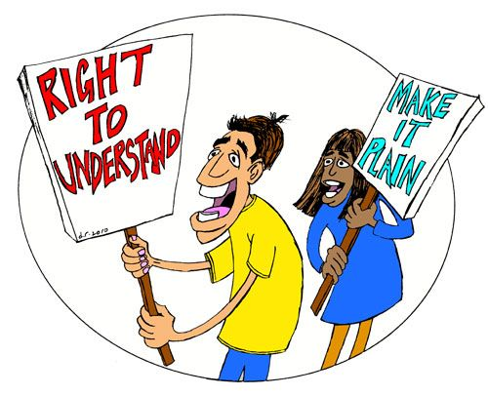
Improving Plain Language Summaries

Slide 4
Quality of Plain Language Summaries
Random sample of 243 plain language summaries (PLS)
24% of the plain language summaries and abstracts didn’t match
*German Cochrane Centre survey– 2004
Notes:
Factual errors
Discrepancy of stated facts between PLS and review
Discrepancy of strength of evidence between PLS and review
Wording errors, etc

Slide 5
Accuracy of PLS Information
Notes:
In 2011, the CEU conducted an audit of the quality of abstracts in new Cochrane Reviews, including their relation to PLS, to see how they conform to format recommendations.
Declarative PLS title
Inconsistency between the abstract and PLS
Discrepancies within the abstracts or between the abstracts and PLSs are the most serious, and frequently encountered issue.
The abstract and PLS are commonly read in isolation from the rest of the review. Discrepancies between the findings reported in the abstract and PLS were also a concern in a few cases.
We identified some discordance between the abstract and PLS in 28% of reviews from our sample. When read in
isolation, this creates differing impressions about the effects of interventions

Slide 6
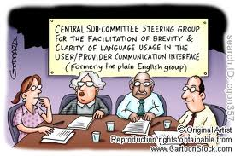
Plain Language Standards

Slide 7
Standards for Plain Language Summaries
Use of Statistics
Explaining Bias
Quality of Evidence
Imprecision

Slide 8
Consumer Understanding of PLS Messages
*Excerpt from Glenton and Santesso presentation to the Co-ordinating Editors Board in 2010 October.
Notes:
2006 Opportunities Fund on PLS
by Nordic Cochrane Centre, Norwegian Branch, Norway
Cochrane Musculoskeletal Group, Canada
Iberoamerican Cochrane Centre, Spain
Centro Colaborador Argentino de la Red Cochrane Iberoamericana, Argentina
Cochrane Consumers and Communication Review Group, Australia
With support and participation from the Consumer Network, Advisory Group, Italian Cochrane Centre
34 participants from participating centres, 3 different versions

Slide 9
Format for Plain Language Summaries
Sentence length
Reading level
Headers and paragraphs
Use of complex terms

Slide 10
Supporting Consumer Involvement

Slide 11
Consumer Growth

Slide 12
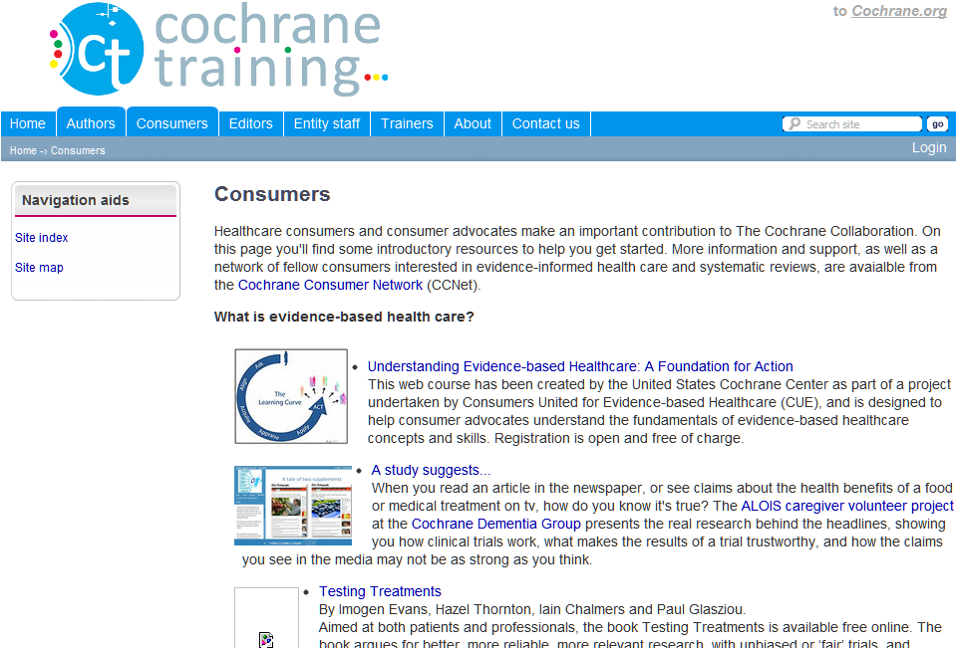
Training New Consumers
Notes:
What is evidence-based health care?
What is The Cochrane Collaboration, and what are systematic reviews?
How can consumers get involved?
How to comment on reviews

Slide 13
Consumer Roles
Notes:
2010 report, 66 consumers were surveyed about their participation in The Collaboration. At the end of 2011, a similar survey, ‘Consumer Demographics Survey,’ was conducted online by the Consumer Co-ordinator. Ninety-six consumers from 26 different countries participated.

Slide 14
Consumer Referee Checklists
Consumer Feedback Essential
Consumer developed
ERC refined
Adherence to MECIR and PLS standards
Pilot phase in progress

Slide 15
Supporting Managing Editors
Including an explanatory guide to accompany the Consumer Referee Checklist
Notes:
Introducing consumers to Cochrane
Explaining systematic reviews
Becoming Consumer referees

Slide 17
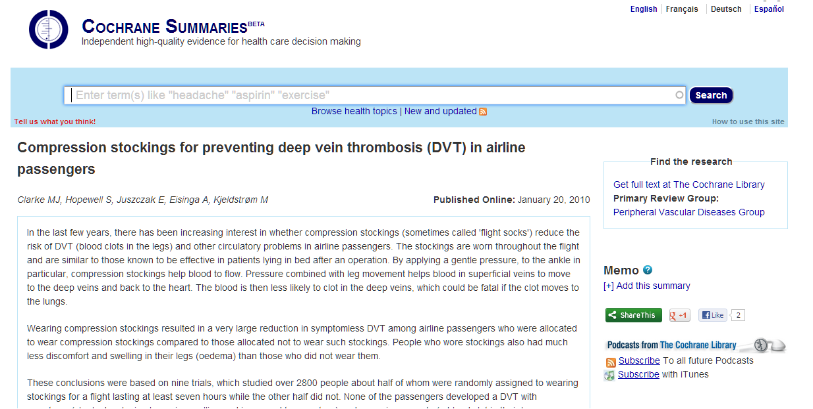
Reaching New Consumers
summaries.cochrane.org
Notes:
The Cochrane Library has traditionally been difficult for consumers to navigate and access to Cochrane Reviews can be for consumers. PLS were designed to resolve these issues but usability remains an issue. Lorne Becker, Chris Mavergames, Martin Janczyk and myself began an innovative project to redesign the display of PLS on cochrane.org for the consumer audience. As the data below illustrates, the majority of users attracted to the site are new to Cochrane Summaries. Additional data collection is needed to determine more about the demographics of its users.

Slide 18
Moving in the Right Direction
European Commission ECRAN Project
Communicating the benefits of European research to the general public”

Slide 19
Involving Consumers from the Start
European Communication on Research Awareness Needs “Communicating the benefits of European research to the general public”
To develop tools to:
communicate key messages to citizens, patients, patients organizations, healthcare professionals, researchers, policymakers and society about independent, multinational clinical research
First key message:
The importance of public understanding of the need for, and basic principles of clinical trials, fostering active involvement of citizens and patients in trials and of their representatives in trial design
Notes:
The ECRAN project is designed to develop a portfolio of open educational resources for the general population about clinical research, in particular independent clinical research
Mario Negri – Italy
Zadig – Italy
INSERM – France
Oxford University Hospitals – UK
Copenhagen University Hospital – Denmark
University Medical Center Freiburg – Germany
European AIDS Treatment Group – Belgium
German Network of the Coordinating Centers for Clincal Trials - Germany

Slide 20
Accessible for Everyone
Notes:
Messages and key words will be addressed using:
different communication tools
a website with an online database of open educational resources in European languages
a film on clinical trials, dubbed in 23 European languages
an international event on multinational clinical trials

Slide 21
Consumer Involvement Could Be...
Notes:
Peer Mentoring to increase involvement

Slide 22
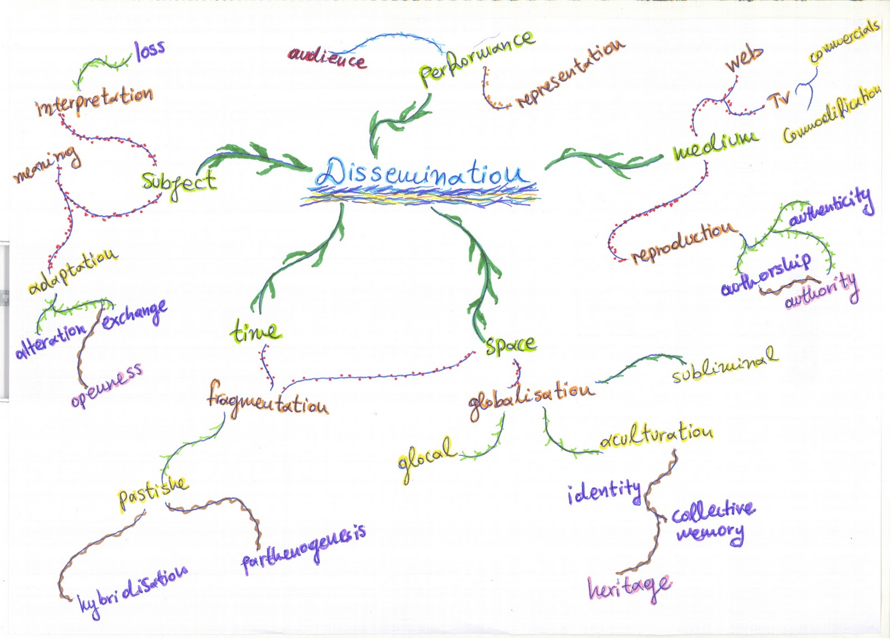
Planning for the Future

